Slide 1

Winners in a PANDEMIC
CWRU-CLE-DATA ANALYSIS BOOTCAMP
David Grimmett - Jon Smart
Andrés Solano - Brittney Hopkins
- Mercan Aslan

Slide 2

Winners in a PANDEMIC
David Grimmett - Jon Smart
Andrés Solano - Brittney Hopkins
Mercan Aslan

Slide 3




A Massive Challenge or a Massive Benefit?
The global COVID-19 pandemic has forced risks and challenges to many industries
Unfortunately, many businesses have been impacted badly –some, forever gone
However, there are some industries/sectors that have benefited tremendously…
COVID 19
??
E-commerce
TOURISM
Technology
FINANCE
Restaurant
industry
??
??
WORKFORCE

Slide 4
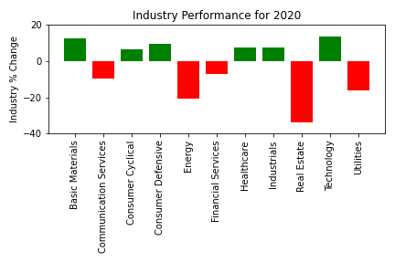
Statistical Analysis on Sector Performance
for 2020

Slide 5
Medical Distribution

Slide 6
Airports

Slide 7
Home Improvement

Slide 8
Conclusions

Slide 9
References
Ohio.gov
Census Business Formation Data
Stock Market Index….’
https://www.thebalance.com/what-are-the-sectors-and-industries-of-the-sandp-500-3957507
Ect…

Slide 10

Thanks!
This guy named Mark that work at Home Depot..
A couple rented their apartment in Santiago, traveled the worl…

